Slide 1


LABORLINK: A WEB-BASED JOB PORTAL WITH UNIFIED COMMUNICATION TECHNOLOGY FOR THE MUNICIPALITIES OF NUEVA ECIJA

Slide 2
Introduction
Addressing Unemployment Through a Web-Based Job Portal
Global Context
Unemployment is a critical macroeconomic issue affecting Southeast Asia, disrupting societal stability, economic growth, and increasing income inequality. Nations like the Philippines, Indonesia, and Thailand face challenges in absorbing their growing workforce due to high unemployment rates, especially among youth and first-time job seekers.

Slide 3
Introduction
Addressing Unemployment Through a Web-Based Job Portal
Local Context
Despite being a fast-growing economy, the Philippines struggles with fluctuating employment rates. With 4.3% in March 2023, and as of May 2024, the unemployment rate stands at 4.1%, showing marginal improvement but highlighting persistent challenges in connecting job seekers with opportunities. (PSA, 2024).

Slide 4
Introduction
Unemployment Rate
4.3%
3.5%
4.1%
March 2023
February 2024
May 2024
65.3%
64.8%
64.8%
Labor Force Participation Rate

Slide 5

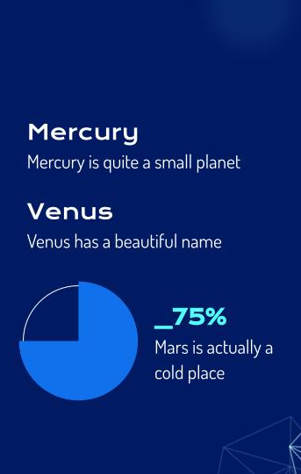
Introduction
Challenges of Blue Collar Workers in the Job Market
Online job portals create fragmented "information islands," making it difficult for job seekers or blue collar workers to find comprehensive opportunities.
High employer fees limit job postings, reducing visibility for qualified applicants.
Employers face rising costs in manually preselecting candidates.

Slide 6
Introduction
This study introduces LaborLink, a web-based job portal designed to connect blue-collar workers and job providers in Nueva Ecija. It aims to:
Bridge the gap between job seekers and employers.
Simplify the job application process using unified communication technologies.
Reduce regional unemployment and promote local economic stability.

Slide 7
Introduction
LaborLink addresses structural barriers faced by blue-collar workers, such as limited access to job listings and inefficient communication with employers, offering a centralized platform to drive meaningful employment connections.

Slide 8
Review of Related Literature
The Role of Job Portals in Modern Recruitment
According to Killewale and Mune (2017), job portals provide features like automatic application filtering, simple access to job postings, and quicker contact between employers and job seekers, which save a lot of time and lessen burdens for both candidates and recruiting personnel.

Slide 9
Review of Related Literature
The Role of Job Portals in Modern Recruitment
Core Benefits
Automated filtering and faster communication save time for job seekers and recruiters (Killewale & Mune, 2017).
Precise and flexible data management improves hiring efficiency (Dorn & Naz, 2007).

Slide 10
Review of Related Literature
The Role of Job Portals in Modern Recruitment
Transformation of Recruitment Processes
Shift from traditional methods (job fairs, newspapers) to digital platforms (Killewale & Mune, 2017).
Online job portals reduce costs and effort while increasing accessibility (Chackravarty, 2017).

Slide 11
Review of Related Literature
Web-Based Job Portal
Key Studies
Sengco et al. (2024):
Focus on blue-collar workers, highlighting demographic trends and employment challenges.
Gopez et al. (2023):
Discussed BlueHire, a platform addressing job accessibility and efficiency for blue-collar workers.

Slide 12
Review of Related Literature
Web-Based Job Portal
Localized Solutions
Putungan et al. (2022):
Developed a workforce assessment system for PESO in Cabuyao City, emphasizing local job matching.
Geneta (2019):
Created a job portal for PESO Rosario, simplifying manual recruitment processes.

Slide 13
Review of Related Literature
Web-Based Job Portal
Improved Job Accessibility
Marjan & Norizan (2014)
Highlighted online job portals as centralized sources for job listings, improving transparency and usability.

Slide 14
Review of Related Literature
Unified Communication Technology (UC)
Role of Technology
UC tools like instant messaging, VoIP, and video conferencing enhance recruitment efficiency by breaking geographical and temporal barriers (Telekom Research, 2011).

Slide 15
Review of Related Literature
Empowering Blue-Collar Workers
Innovative Platforms
Dukare (2022):
Developed a platform focused on matching job seekers with suitable roles, improving access to opportunities in urban and rural areas.

Slide 16
Review of Related Literature
Empowering Blue-Collar Workers
Career Development
Platforms enhance career growth by matching skills to job requirements and providing efficient application processes (Nguyen, 2024).

Slide 17

Conceptual Framework
Research Paradigm ( Figure 1.)
Input
Process
Output
1.How may the profile of the respondents be described in terms of:
•Age;
•Sex;
•Marital Status;
•Educational Attainment;
•Educational Background;
•Income; and
•Address?
2.How may the respondents evaluate the proposed system regarding:
•Maintainability;
•Functionality;
•Usability;
•Effectivity;
•Reliability;
•Efficiency;
•Security; and
•Portability?
3.How does the proposed system change the traditional job acquisition process?
4.What are the problems that the respondents encounter while using the proposed system?
5.What additional features that respondents want to recommend to enhance the performance of the proposed system?
•Mixed Methods
•Snowball Sampling
Laborlink: A Web-Based Job Portal with
unified communication technology for the municipalities of Nueva Ecija

Slide 18
Conceptual Framework
System Paradigm ( Figure 2.)
Input
Process
Output
• Brainstorming
• Assessing the Problem
• System Conceptualization
• User Requirements
• System Requirements
• Resource Gathering
• System Development Preparation
Software Development
Life cycle
• Planning
• Analysis
• Designing
• Development
• Testing
• Deployment
• Maintenance
A fully functional Web-Based Job Portal with Unified Communication Technology for the Municipalities of Nueva Ecija

Slide 19
Statement of the Problem
1.How may the profile of the respondents be described in terms of:
1.1Age;
1.2Sex;
1.3Marital Status;
1.4Educational Attainment;
1.5Educational Background;
1.6Income; and
1.7Address?

Slide 20
Statement of the Problem
2.How may the respondents evaluate the proposed system regarding:
2.1Maintainability;
2.2Functionality;
2.3Usability;
2.4Effectivity;
2.5Reliability;
2.6Efficiency;
2.7Security; and
2.8Portability?

Slide 21
Statement of the Problem
3.How does the proposed system change the traditional job acquisition process?

Slide 22
Statement of the Problem
4.What are the problems that the respondents encounter while using the proposed system?

Slide 23
Statement of the Problem
5. What additional features that respondents want to recommend to enhance the performance of the proposed system?

Slide 24
1. To categorize and analyze the demographic characteristics of the respondents, including age, sex, educational attainment, and address.
2. To enhance accessibility by creating a user-friendly interface that allows job seekers, including those in rural areas, to easily search and apply jobs.
3. To support local employment by focusing on local businesses, reducing the need for residents to seek work outside the region, and boosting the local economy.
Objectives of the Study
4. To integrate unified communication tools to facilitate direct interactions and expedite hiring decision.
5. To evaluate the effectiveness of the Laborlink’s features by gathering user-feedback on its functionalities.

Slide 25
Scope and Delimitations of the Study
This study focuses on developing and evaluating Laborlink, a web-based job portal with unified communication technology for blue-collar workers and job providers in Nueva Ecija. The platform aims to address challenges in job accessibility and recruitment by offering tools for virtual interviews and direct communication, enhancing local employment opportunities, and streamlining the hiring process through a user-friendly interface.

Slide 26
Scope and Delimitations of the Study
The study is limited to municipalities in Nueva Ecija and does not extend to other regions or professional job categories. It excludes advanced features like AI-driven job matching, focusing instead on unified communication to improve human interaction. This localized and targeted approach ensures the platform meets the specific needs of the community.

Slide 27
Significance of the Study
For the community, it promotes local employment by connecting blue-collar workers with job opportunities in Nueva Ecija, reducing migration, and strengthening the local economy.

Slide 28
Significance of the Study
For government agencies, it provides a model for addressing unemployment locally, aligning with national goals and serving as a reference for similar initiatives.

Slide 29
Significance of the Study
For educational institutions and curriculum developers, the research highlights the need for skills aligned with local job demands, offering insights to improve curriculum and career preparedness.

Slide 30
Significance of the Study
For job providers, the platform simplifies recruitment by offering access to qualified candidates and reducing hiring costs.

Slide 31
Significance of the Study
For job seekers, especially in rural areas, Laborlink provides a convenient way to find local jobs that match their skills, improving their employment opportunities.

Slide 32
Significance of the Study
For science and technology, the study demonstrates how digital platforms can address real-world issues like unemployment, supporting economic growth while advancing knowledge in web development and communication technologies.

Slide 33
Significance of the Study
For future researchers, it serves as a resource for exploring digital employment solutions, unified communication tools, and the socio-economic impacts of technology, offering valuable insights for similar projects worldwide.

Slide 34
RESEARCH METHODOLOGY
Research Design
This study uses a mixed-method approach, combining both qualitative and quantitative research to provide a comprehensive understanding of the research problem. By integrating both methods, researchers can corroborate findings, expand interpretations, and generate well-rounded conclusions. The mixed-method approach helps describe the relationships among variables such as demographic profiles, system evaluation metrics, and the impact of the proposed platform on the traditional job acquisition process.

Slide 35
RESEARCH METHODOLOGY
Research Design
The qualitative method captures in-depth insights into the challenges and experiences of users, while the quantitative approach gathers measurable data on system evaluation aspects like maintainability, usability, and reliability. This combination allows the researchers to offset the limitations of using only one method, ensuring a more comprehensive understanding of the study's findings. The goal is to develop a centralized platform to connect blue-collar workers and job providers in Nueva Ecija, streamlining the recruitment process.

Slide 36
RESEARCH METHODOLOGY
Research Locale
This study focuses on Nueva Ecija, a province in the Central Luzon region of the Philippines, known as the Rice Bowl of the Philippines due to its significant rice production. Despite its agricultural prominence, the province faces unemployment challenges, especially among blue-collar workers. Many residents have limited access to technology and the internet, making it difficult for them to search for job opportunities. With 27 municipalities and five cities, Nueva Ecija has a population of over 2.3 million people and is an ideal locale for implementing a web-based job portal to improve employment accessibility for local workers.

Slide 37
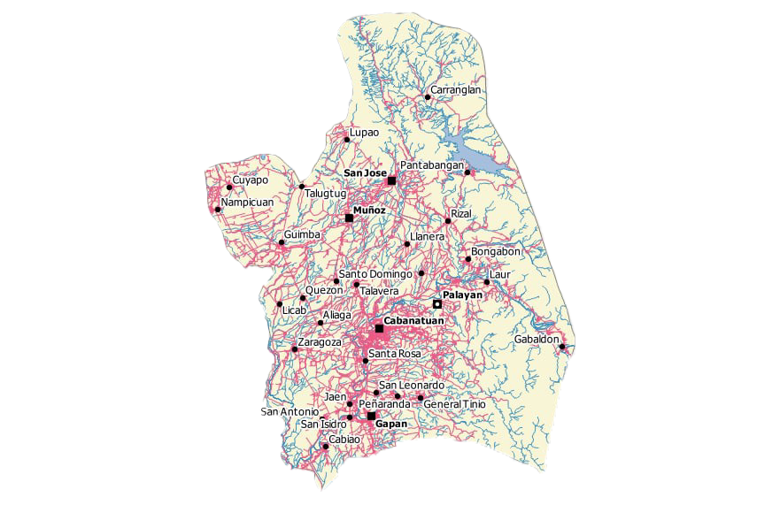
Research Locale
Map of Nueva Ecija

Slide 38
Sample and Sampling Procedure
Selected Municipalities
Respondent | Total Population | Sample
Cabanatuan Gapan Jaen San Leonardo Santa Rosa Zaragoza | 79,619 348 501 1,006 1,016 526 | 368 2 3 5 5 3
Total | 83,016 | 386

Slide 39
Raosoft is used to compute the recommended sample size of the study from a big population.
Raosoft Calculator:
Confidence level = 95%
Population size(N) = 83,016
Margin of Error(MOE) = 5 %
Response distribution (p) = 50%
Formula
n = N * X / (X + N - 1)
where X = Zα/2² * p * (1-p) / MOE²
Sample size = 386

Slide 40
RESEARCH METHODOLOGY
The sampling method used in this research was the snowball sampling technique to select the respondents. In this method, researchers identify initial participants who meet specific criteria and then rely on these participants to refer others within their network who also possess the desired characteristics, experiences, or knowledge to achieve the research goals.

Slide 41
Data Gathering Procedure & Data Gathering Instrument
A structured questionnaire will collect data from blue-collar workers and employers in Nueva Ecija about the Laborlink portal.
Snowball sampling will ensure diverse representation.
Questionnaires will be distributed face-to-face, with research team members interacting directly with participants in local communities.
Data will be analyzed using statistical tools, and results will be compiled into a report for stakeholders and participant feedback.

Slide 42
Data Analysis Technique
This research employs a mixed methods approach, combining qualitative and quantitative analysis techniques. For demographic data, frequency and percentage distributions will be used to assess the population's characteristics.

Slide 43
Data Analysis Technique
Qualitative data will be analyzed using an inductive thematic approach to identify recurring themes and concepts from respondents' thoughts and experiences, without preconceived ideas.

Slide 44
Data Analysis Technique
For quantitative data, the weighted mean will be calculated, and a four-point Likert Scale will be used to gather responses, ensuring more precise insights by eliminating the neutral option. This approach is ideal for analyzing feedback on goods and services.

Slide 45
Rating Scale
Degree of Response | Range | Verbal Description | Verbal Interpretation
4 | 3.25 – 4.00 | Strongly Agree | The respondents strongly agree to the statement provided
3 | 2.50 – 3.24 | Agree | The respondents agree to the statement provided
2 | 1.75 – 2.49 | Disagree | The respondents disagree to the statement provided
1 | 1.00 – 1.74 | Strongly Disagree | The respondents strongly disagree to the statement provided

Slide 46
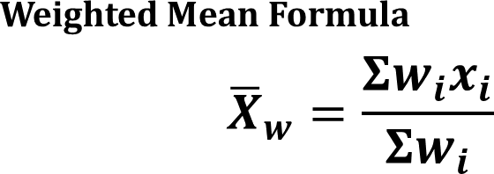
Weighted Mean Formula
The weighted mean equation is used as a statistical method to calculate the weighted average of the quantitative data.
Where:
x̅w = Weighted Mean variable
w_{i} = weight of the item
x_{i} = value of the item

Slide 47
THE END
Thanks for Listening!

Slide 48
GROUP 2 | BCSS-4B
Presented By :
Mary Grace Mariano
Jackielou Sansait
Dan Michael Merin
Vincent Teresa
Franz Eriel Lopez
Christian Flores

